Slide 1
DCGAN BASED BRAIN METASTASES DETECTION USING LIMITED LABELED DATASET
Name | Usn
Sushant Huilgol | 01FE17BCS424
Tanushree Kale | 01FE16BCS216
Rakesh Kuratti | 01FE17BCS419
Pracheth M H | 01FE16BCS096
Guide: Dr. Shrinivas D Desai.
Team: 13

Slide 2
Agenda
Introduction
Motivation
Literature Survey & Research Gaps
Problem Statement & Objectives
Dataset
Proposed Model
Results and Discussions
Conclusion & Future Work
References

Slide 3
Introduction:
Importance of brain in the human body.
Complication during the detection of brain tumour due to various factors of the tumor.
Importance of early detection of tumor.
MR Images are preferred due to its superior image quality by most of the experts.
Need of Computer Aided Diagnosis(CAD) system to detect brain tumour.

Slide 4
Motivation
Accurate Computer-Assisted Diagnosis, associated with proper data wrangling, can alleviate the risk of overlooking the diagnosis in a clinical environment.
However in many situations either data is limited or labeling is limited.
GAN as a Data Augmentation technique can synthesize the images using the real images.
The images are closer to the real images and are also evenly distributed.
The need of the hour is to develop DCGAN based model to generate synthetic images to address the issue of limited labeled data problem in tumor classification problem.

Slide 5
Facts & Figures of Brain Tumor Cases in India:
Brain tumor is the second most common cancer among children after leukemia.
In India, every year 40,000-50,000 persons are diagnosed with brain tumours, out of which 20 percent are children.
Until 2015, the figure was only somewhere around 5 percent.
Only six per cent of the children suffering from brain tumours are able to get the proper treatment.
The doctors said that if the cases are detected early, then 90 per cent of the cases are curable, provided the treatment protocol is followed correctly.
The health experts have also said that if the treatment is done in time, the children can live up to 70-80 years without any problem.

Slide 6
Literature Survey
Sl.No | Author Name and Year | Title of the Paper | Dataset | Classifier | Result | Limitations
1 | Praveen G V, 2018 | Hybrid approach for brain tumour detection and classification in MRI | BRATS and Real time MRI scans obtained at Goa medical college | LSSVM | 96.63% | Use of 100 images (25-normal 75- abnormal) For both training and testing.
2 | Hossam H. Sultan, 2019 | Multi-Classification of Brain Tumour Images Using Deep Neural Network | Nanfang Hospital and General Hospital, Tianjing Medical University, China | CNN | 97% | Dataset is not relatively big.(Solution used Data Augmentation)

Slide 7
Literature Survey(cont..)
Sl.No | Author Name and Year | Title of the Paper | Dataset | Classifier | Result | Limitations
3 | Mohammad Teshnehlab, 2019 | Brain Tumour detection using DNN and ML algorithms | 19 MRI FLAIR and BRATS 2012 | CNN | 99.12% | Data on 153 patients.
4 | Pradeep Kumar Mallick, 2019 | Brain MRI Image Classification for Cancer Detection Using Deep Wavelet Autoencoder-Based Deep Neural Network | RIDER | Deep wavelet auto encoder | 96% | Data on 19 patients.

Slide 8
Literature Survey(cont..)
Sl.No | Author Name and Year | Title of the Paper | Dataset | Classifier | Result | Limitations
5 | Odelin Charron, 2018 | Automatic detection and segmentation of brain metastases on multimodal MR images with a deep convolutional neural network | No information about the dataset | CNN | 98% | Database composed of 182 patients
6 | Konstantinos Kamnitsas, 2017 | Efficient multi-scale 3D CNN with fully connected CRF for accurate brain lesion segmentation | TBI( Traumatic Brain Injury ) dataset, BRATS 2015 and ISLES 2015. | CNN | 89.48% | Performance drop when using BRATS and ISLES dataset
7 | Mohammadreza Soltaninejad, 2017 | Automated brain tumour detection and segmentation using superpixel-based extremely randomized trees in FLAIR MRI | Own collected (19 MRI) BRATS 2012 dataset | Support Vector Machine (SVM) | 88.09% | Super pixels can not improve the accuracy of feature Extraction

Slide 9
Research Gaps:
Limited Dataset (min 60, max 400 annotated images) used in the papers
Error due to manual annotation may contribute significantly on outcome
Most of the experiments are carried on limited annotated data for brain MRI and chest nodules.
Performance drastically drops when dataset from BRATS or ISLES is used.
Differences in Modality and technical specifications types have significant effect on images.
Conventional DNN, AI, ML have reported less accuracy, false positive when tested. Some literatures have claimed better accuracy, but have not validated the results with medical experts.

Slide 10
Problem Statement & Objectives
Deep Convolutional Generative Adversarial Networks (DCGAN) based data augmentation for brain metastases detection using limited labeled MR Images.
To develop a model using Deep Convolutional Generative Adversarial Network (DCGAN) for the synthesis of brain image dataset.
Evaluate and validate the model.

Slide 11
Dataset:
Dataset used, contains 253 brain images in which:
98 tumour images
155 non-tumour images
For GAN training the entire dataset is used which has 253 images each of size 200*200.
For Tumour detection the whole dataset is divided into training, testing and validation set.
 | Training set | Validation set | Testing set
Conventional CNN | 176 | 39 | 38
Synthetic Images(57 Images) | 233 | 39 | 38
Synthetic Images(85 Images) | 261 | 39 | 38

Slide 12
PROPOSED MODEL:

Slide 13
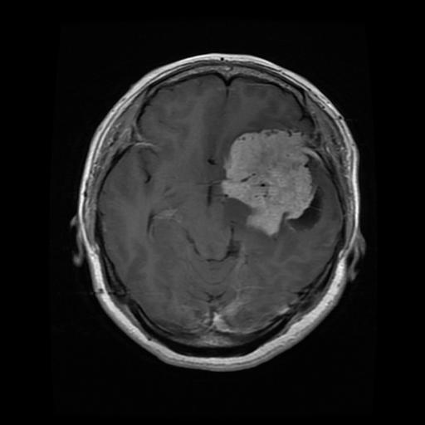
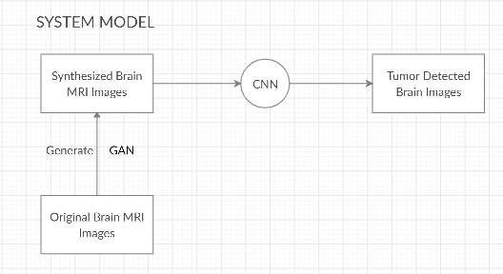
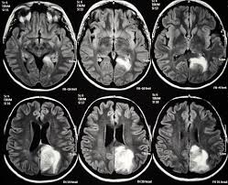
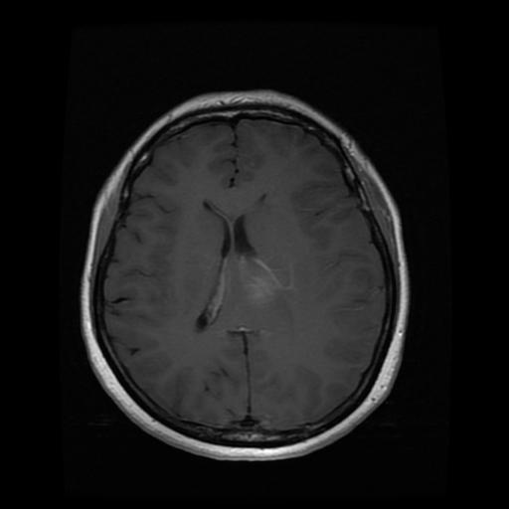
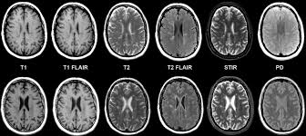
System Overview Diagram:
Tumored
Non-Tumored

Slide 14
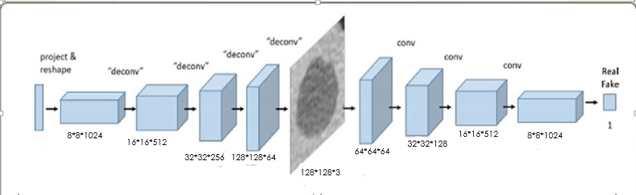
System Architecture 3D:

Slide 15
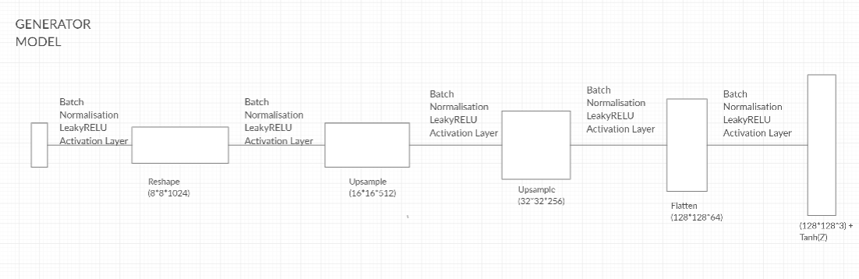
System Architecture (Generator Model):

Slide 16
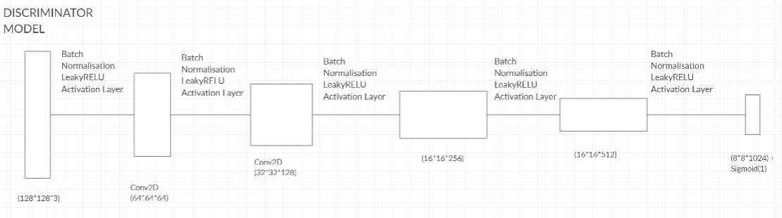
System Architecture (Discriminator Model):

Slide 17
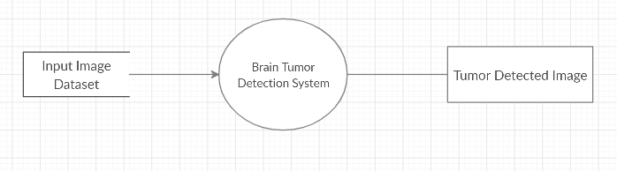
Level 0: Data Flow Diagram:

Slide 18
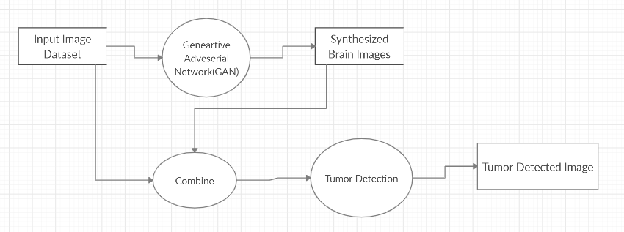
Level 1: Data Flow Diagram:

Slide 19
Model Inputs:
Generator input: resize the image to the previous generator’s output resolution/channel size and concatenate them (noise samples generate the first 4×4 images)
Discriminator input: concatenate the conditioning image with a real or synthetic image.
The model uses a U-net architecture.

Slide 20
Hyper Parameters Proposed for GAN:
Parameter | Parameter Value
Noise | 100
Learning Rate Discriminator | 0.00003
Learning Rate Generator | 0.0003
Batch Size | 64 & 4
Epochs | 1000
Beta1 | 0.5
Weight Initialized to | 0.02
Epsilon | 0.00005
Samples size | 85

Slide 21
Hyper Parameters Proposed for CNN:
Parameter | Parameter Value
Optimizer | rmsprop
Loss | binary_crossentropy
Activation | ReLU
Augmentations | Horizontal flip Horizontal shift Vertical shift Rotation
Epochs | 15

Slide 22
RESULTS & DISCUSSIONS

Slide 23
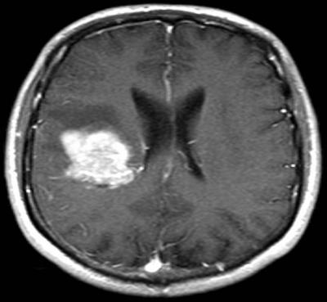
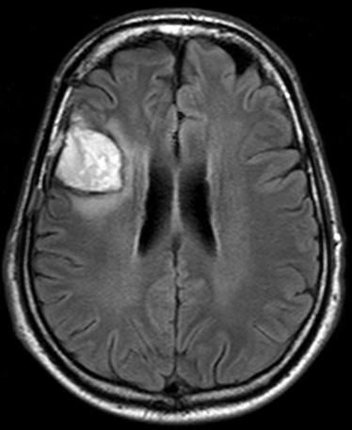
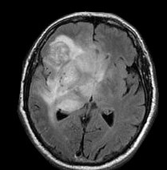
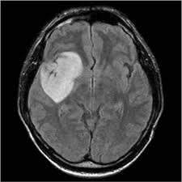
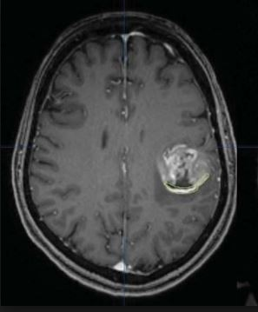
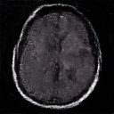
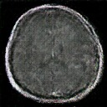
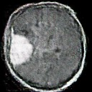
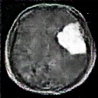
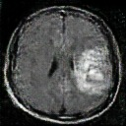
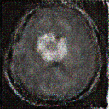
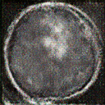
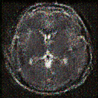
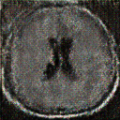
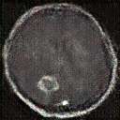
Comparison of Original images and Synthesized images:
Images from the original dataset
Images from synthesized data generated for batch size 4
Images from synthesized data generated for batch size 64

Slide 24
Evolution of the Generator Model:

Slide 25
Experiments Conducted:
In Order to evaluate the proposed model and to visualize the data with respect to its closeness to the original dataset, the following 4 experiments were conducted:
Performance evaluation of CNN with and without GAN generated images.
Similarity study using Histogram and Image profile.
Visual Turing Test Results
Model Evaluation

Slide 26
Exp 1: Performance evaluation of CNN with & without GAN generated images
 |  | Batch size=64 |  | Batch size=4
Parameters | Without GAN | With-GAN (60 Images) | With-GAN (85 Images) | With-GAN (60 Images) | With-GAN (85 Images)
Accuracy | 81.57 | 94.73 | 84.21 | 81.57 | 84.21
Sensitivity | 100 | 100 | 100 | 100 | 100
Specificity | 53.33 | 86.67 | 60 | 53.33 | 60
Efficiency | 78.30 | 93.80 | 81.40 | 78.30 | 81.40
F1-score-Testing data | 86.79 | 95.83 | 88.46 | 86.79 | 88.46
ROC | 0.767 | 0.933 | 0.791 | 0.80 | 0.80
Results of various parameters calculated for 60 and 85 synthesized images for both the batch sizes 64 & 4

Slide 27
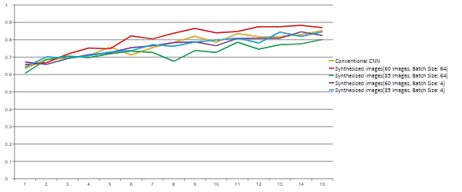
Exp 1: Performance evaluation of CNN with and without GAN generated images. (Contd..)
Graph to represent the accuracy of each epoch for various batch sizes and synthesized images

Slide 28
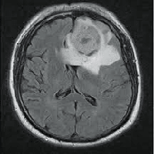
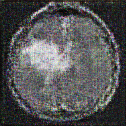
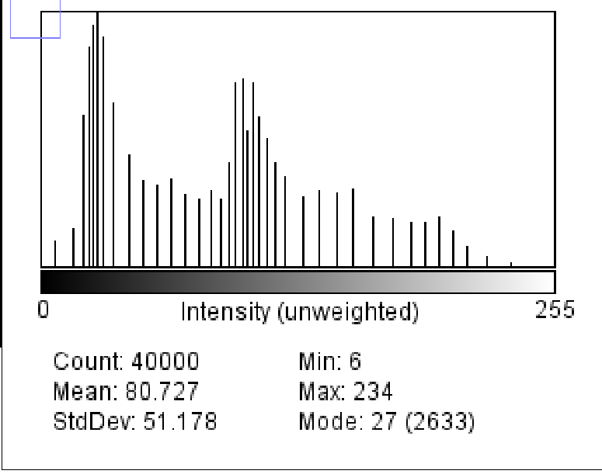
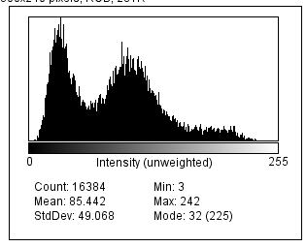
Exp 2: Similarity study using Histogram and Image profile
Original Brain MRI Image | GAN generated synthetic (Batch size=64)
Histogram (Original Image) | Histogram (Synthetic Image)
Table to represent the histogram results for the images shown above.

Slide 29
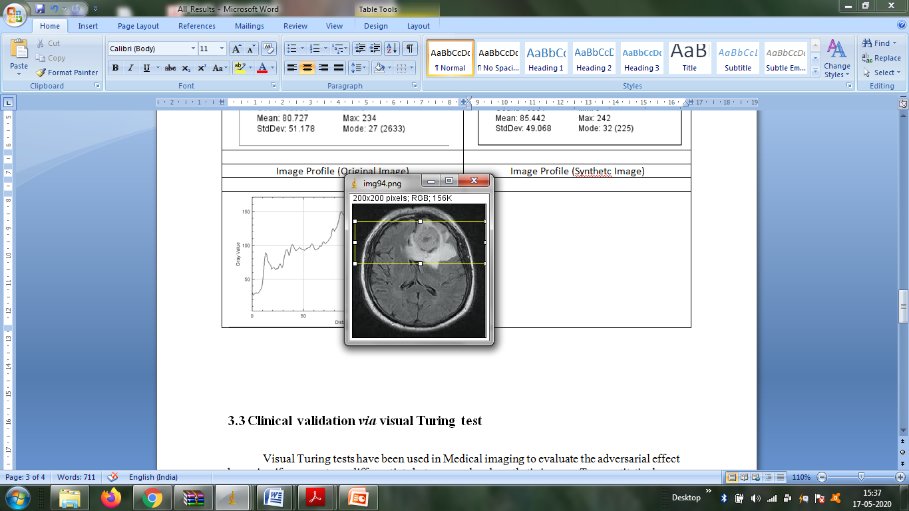
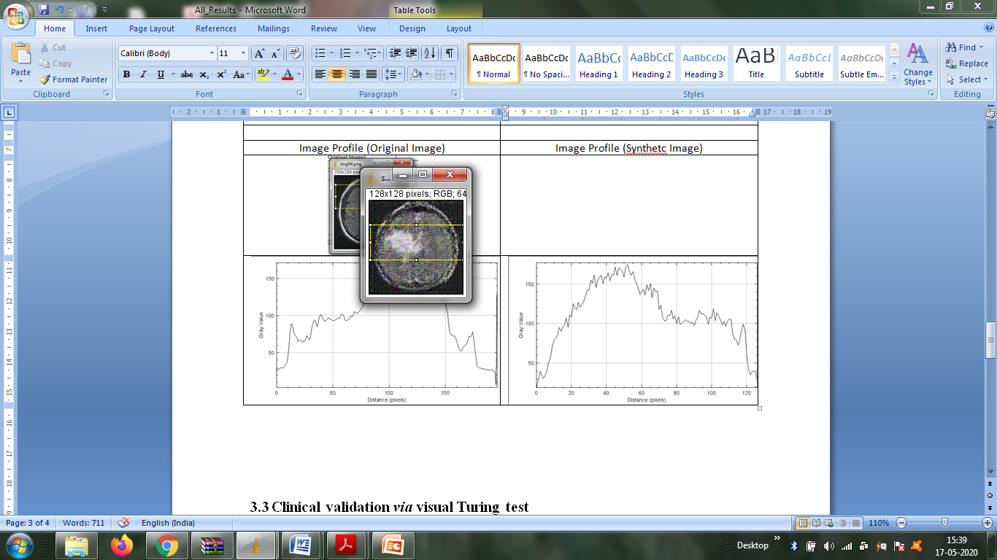
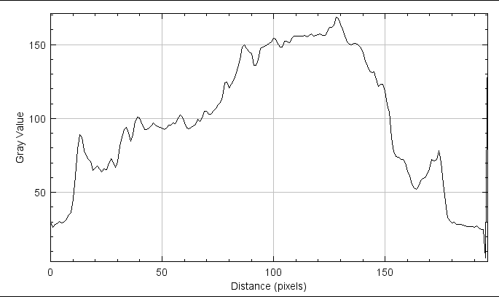
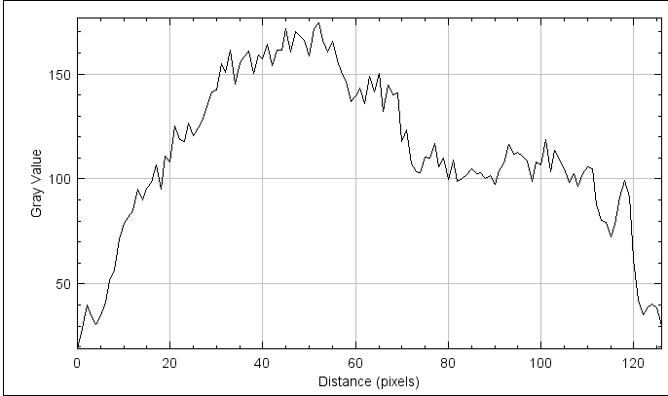
Exp 2: Similarity study using Histogram and Image profile
Image Profile (Original Image) | Image Profile (Synthetic Image)
Table to represents the gray value distribution for the respective images

Slide 30
Exp 2: Similarity study using Histogram and Image profile
Original Brain MRI Image |  | GAN generated synthetic (Batch Size 64) |  | Abs. Difference between original and synthetic images
Mean | Standard Deviation | Mean | Standard Deviation | Mean | Standard Deviation
80.727 | 51.178 | 85.442 | 49.068 | 4.715 | 2.11
44.633 | 42.996 | 39.611 | 44.209 | 5.022 | 1.213
54.605 | 47.269 | 42.461 | 38.954 | 12.144 | 8.315
39.614 | 45.698 | 36.868 | 52.632 | 2.746 | 6.934
105.882 | 77.673 | 123.437 | 69.893 | 17.555 | 7.78
Closeness of original images with synthesized images of batch size 64
Original Brain MRI Image |  | GAN generated synthetic (Batch size=4) |  | Abs. Difference between original and synthetic images
Mean | Standard Deviation | Mean | Standard Deviation | Mean | Standard Deviation
68.054 | 49.841 | 66.888 | 53.243 | 1.166 | 3.402
100.837 | 56.007 | 72.481 | 65.935 | 44.83 | 9.928
54.378 | 30.299 | 89.326 | 66.916 | 34.948 | 36.617
106.046 | 77.610 | 36.092 | 39.807 | 69.954 | 37.803
54.485 | 47.142 | 60.154 | 48.207 | 5.669 | 13.012
Closeness of original images with synthesized images of batch size 4

Slide 31
Exp 3: Visual Turing Test Results
Original images = 100
GAN generated = 87
Batch size: 64
 | Accuracy | TP (Real as real) | FN (Real as Synthetic) | FP (Synthetic as Real) | TN (Synthetic as Synthetic)
Physician 1 | 96.25% | 98 | 2 | 5 | 82
Physician 2 | 96.25% | 97 | 3 | 4 | 83
Results of Visual Turing Test conducted with 2 expert physicians

Slide 32
Exp 4: Model Evaluation
Paper | Method used | Results without DA (%) | Results with DA (%) | Increment Factor
Inﬁnite Brain MR Images: PGGAN-based Data Augmentation for Tumor Detection, Changhee Han | Progressive Growing of GANs (PGGANs) | 90.06 | 91.08 | 1.02
Brain Tumor Classiﬁcation Using ResNet-101 Based Squeeze and Excitation Deep Neural Network, Palash Ghosal | The transformations were Flip, Rotate, Elastic transform and Shear with variable degrees of transformations | 89.93 | 98.67 | 8.74
Multi-Grade Brain Tumor Classiﬁcation using Deep CNN with Extensive Data Augmentation, Muhammad Sajjad | Various augmentation techniques used: rotation, flipping, skewness, and shears for geometric transformations. | 93.34 | 96.12 | 2.78
Proposed Model | Deep Convolutional GANs (DCGANs) | 81.57 | 94.73 | 13.16

Slide 33
Conclusion:
Unavailability of medical images due to the confidentiality of patient data in the hospitals and limited public data access.
Generative Adversarial Network based Data Augmentation to reduce the above problem.
Convolutional Neural Network is used for detection of tumored images.
Experiments were conducted to assess and validate the model
Performance evaluation of CNN with and without GAN generated images.
Similarity study using Histogram and Image profile.
Visual Turing Test Results
We achieved an accuracy of 94.37% after implementing DCGAN which had an increment factor of 13.16 over conventional CNN (81.57%).
An average mean of 8.43 and an average standard deviation of 5.27 was achieved, when the similarity check between original and synthetic images was done.

Slide 34
Conclusion: (Contd…)
Visual Turing Test was conducted with the help of 2 expert physicians to differentiate between original and synthetic images.
Model evaluation was done to compare the accuracy of the proposed model with other models that used Data Augmentation.
Maximum increment factor of the proposed model (13.16) was greater than the other projects (8.74).
As a future scope one shall experiment with other medical cases such as breast cancer classification or other cases.

Slide 35
References:
[1] Frid-Adar, Maayan, et al. "Synthetic data augmentation using GAN for improved liver lesion classification." 2018 IEEE 15th international symposium on biomedical imaging (ISBI 2018). IEEE, 2018.
[2] Jiang, Jue, et al. "Tumor-aware, adversarial domain adaptation from ct to mri for lung cancer segmentation." International Conference on Medical Image Computing and Computer-Assisted Intervention. Springer, Cham, 2018.
[3] Onishi, Yuya, et al. "Automated pulmonary nodule classification in computed tomography images using a deep convolutional neural network trained by generative adversarial networks." BioMed research international 2019 (2019).
[4] Dey, Raunak, Zhongjie Lu, and Yi Hong. "Diagnostic classification of lung nodules using 3D neural networks." 2018 IEEE 15th International Symposium on Biomedical Imaging (ISBI 2018). IEEE, 2018.

Slide 36
References:
[5] Milletari, Fausto, Nassir Navab, and Seyed-Ahmad Ahmadi. "V-net: Fully convolutional neural networks for volumetric medical image segmentation." 2016 Fourth International Conference on 3D Vision (3DV). IEEE, 2016.
[6] Article by “The Hindu” regarding the statistics of Brain Tumor Cases in India: https://www.thehindu.com/sci-tech/health/Over-2500-Indian-kids-suffer-from-brain-tumour-every-year/article14418512.ece
[7] ImageJ- The tool used to visualize the closeness between the original and synthesized images: https://imagej.net/Welcome
[8] The dataset from Kaggle on which the project was worked on: https://www.kaggle.com/navoneel/brain-mri-images-for-brain-tumor-detection
[9] Information about GAN and DCGAN:https://medium.com/@jonathan_hui/gan-dcgan-deep-convolutional-generative-adversarial- networks-df855c438f

Slide 37
Thank You

